Slide 1


<Name>
<Date>

Slide 2

Outline
Executive Summary
Introduction
Methodology
Results
Conclusion
Appendix

Slide 3
Executive Summary
This project analyzes SpaceX Falcon 9 launch data to understand the factors influencing first-stage landing success.
The workflow includes data collection (API + web scraping), data wrangling, exploratory data analysis (visual + SQL), interactive analytics (Folium + Plotly Dash), and predictive modeling.
Key findings show that launch site, booster version, payload mass, and orbit type strongly correlate with landing success.
A Decision Tree model achieved the best performance, making it suitable for estimating future mission outcomes

Slide 4
Introduction
SpaceX significantly reduces launch costs by recovering and reusing Falcon 9 first-stage boosters. Understanding what drives successful landings is crucial for improving reliability and reducing mission cost.
This project aims to answer the central question: Can we predict whether a Falcon 9 first stage will land successfully based on historical launch data?

Slide 5

Section 1

Slide 6
Methodology
Executive Summary
Data collection methodology:
Collected launch records using SpaceX REST API and web scraping.
Perform data wrangling
Cleaned, transformed, and harmonized raw launch data for analysis.
Conducted using Python visualizations and SQL queries to identify trends and key factors.
Created geospatial visualizations with Folium and a fully interactive dashboard with Plotly Dash.
Perform predictive analysis using classification models
Built, tuned, and evaluated multiple ML models (Logistic Regression, SVM, KNN, Decision Tree).

Slide 7
Data Collection
Collected SpaceX Falcon 9 launch data from two primary sources:
Public SpaceX REST API
Web scraping of launch records from HTML tables
Extracted key attributes such as payload mass, orbit type, launch site, booster version, and landing outcome.
Combined datasets into a consolidated analytical DataFrame using Python.

Slide 8
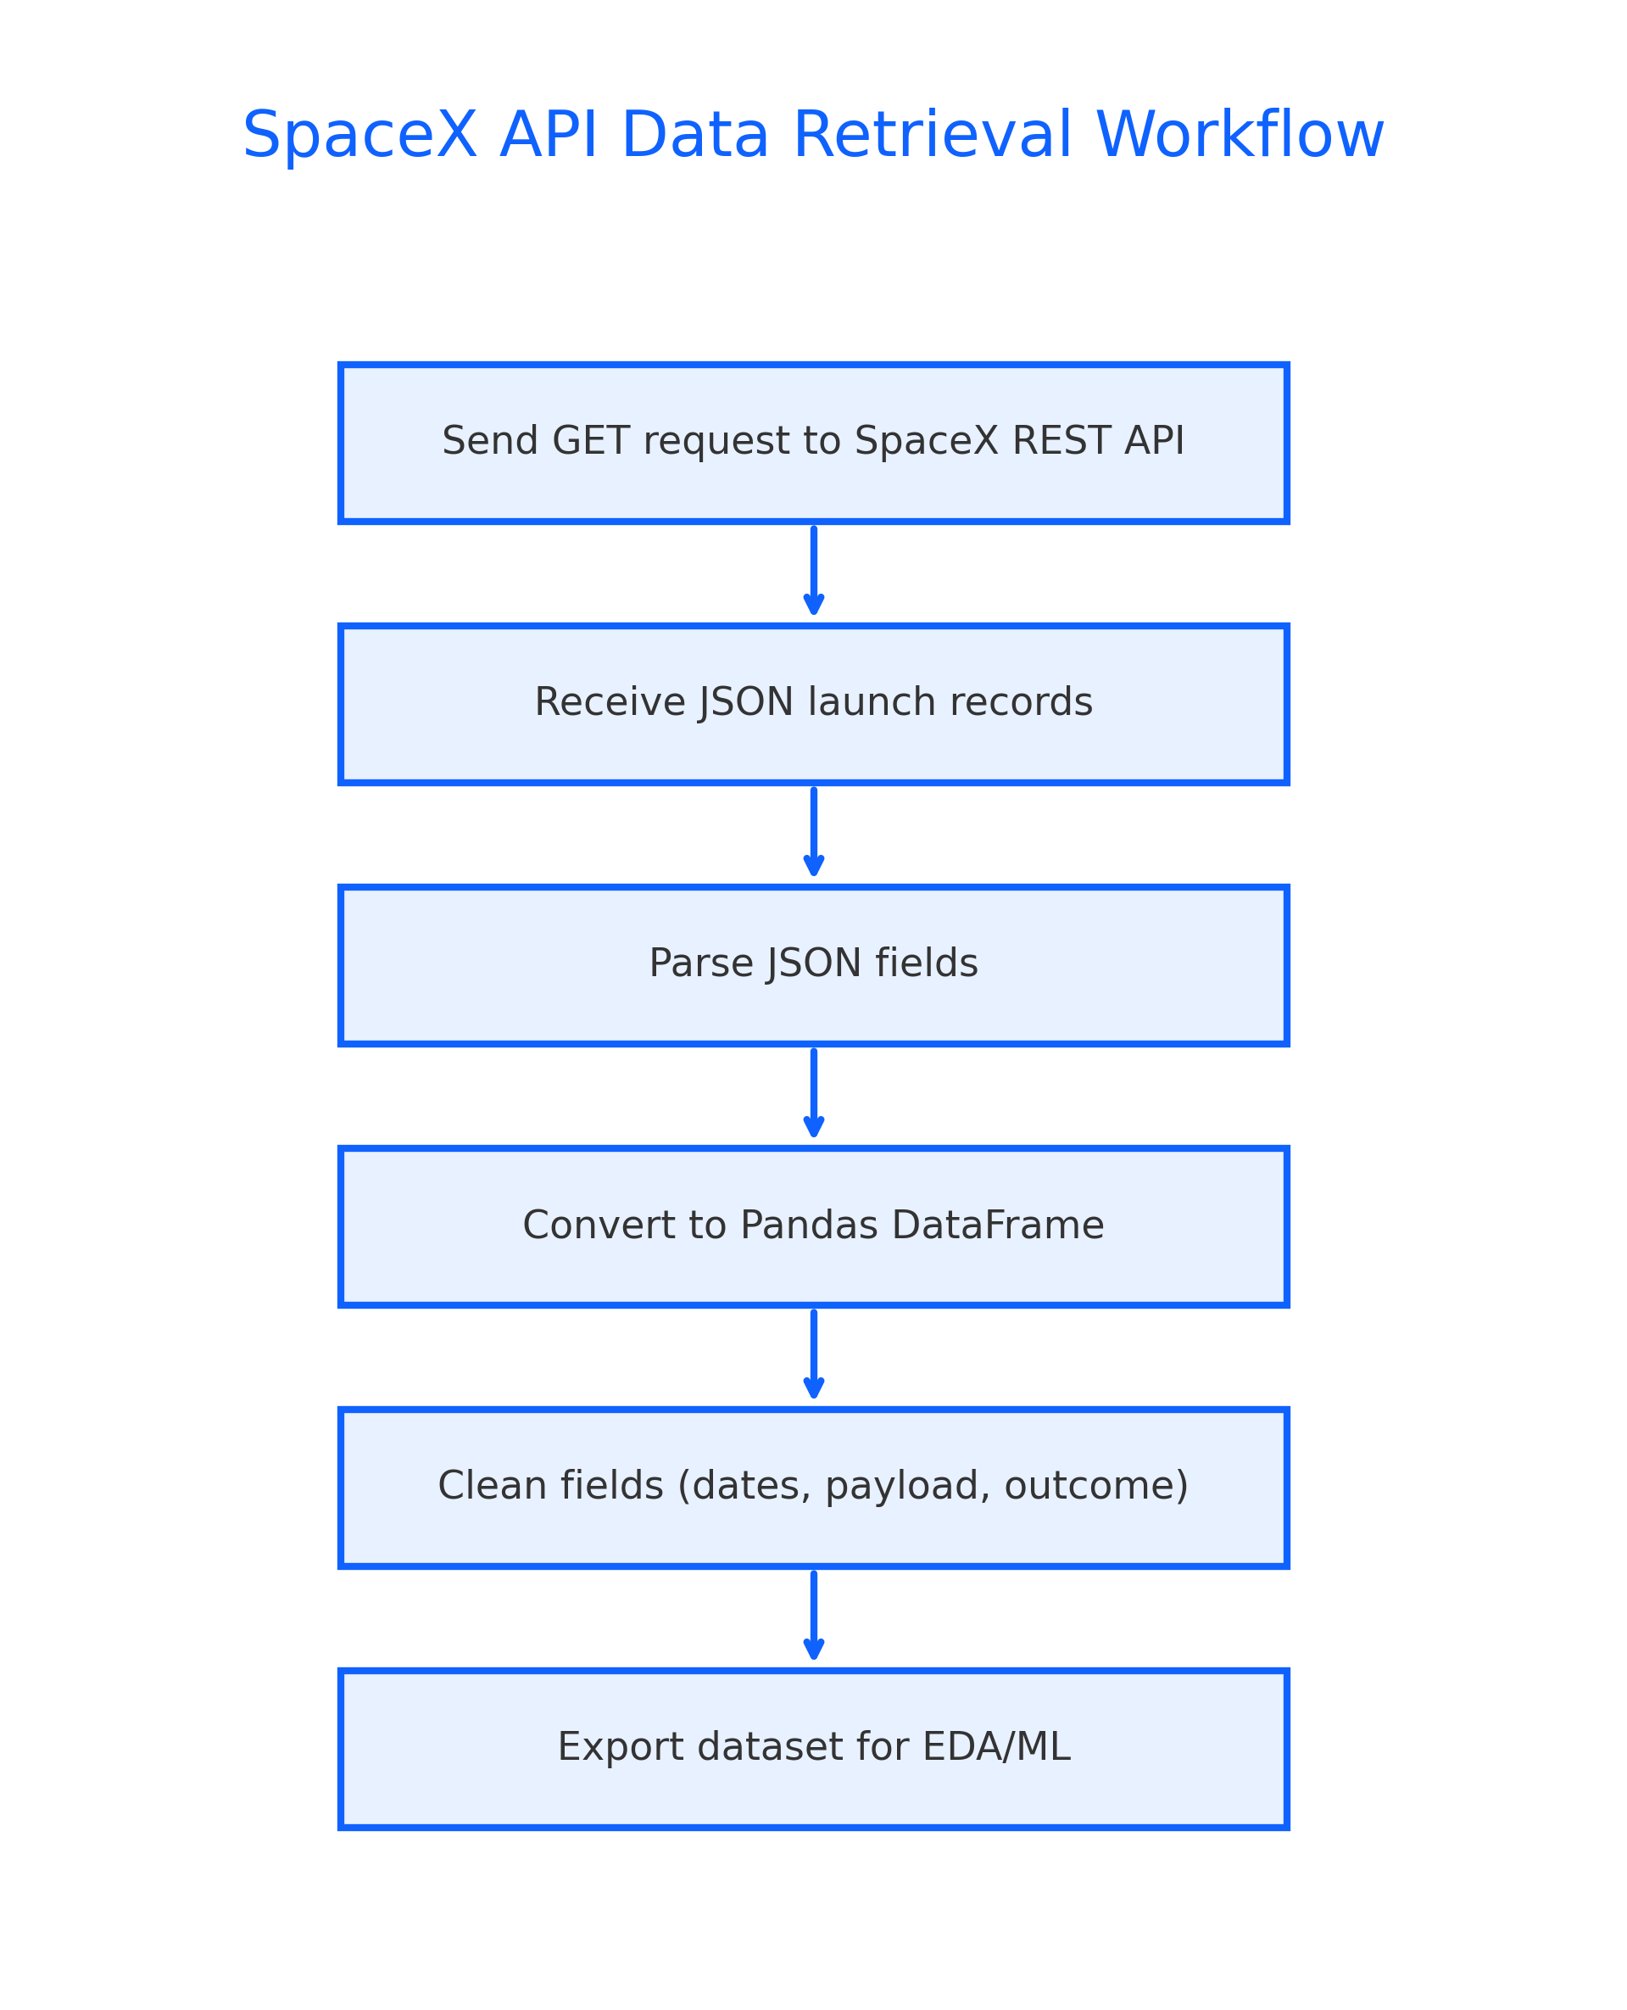
Data Collection – SpaceX API
Data Collection – SpaceX API
Retrieved launch metadata via SpaceX REST API using requests and JSON parsing.
Extracted fields: launch site, orbit, flight number, payload mass, booster version, and landing outcome.
Transformed API output into structured tables for further analysis.
https://github.com/GyorfiCsaba/AppliedDataScienceCapstone

Slide 9
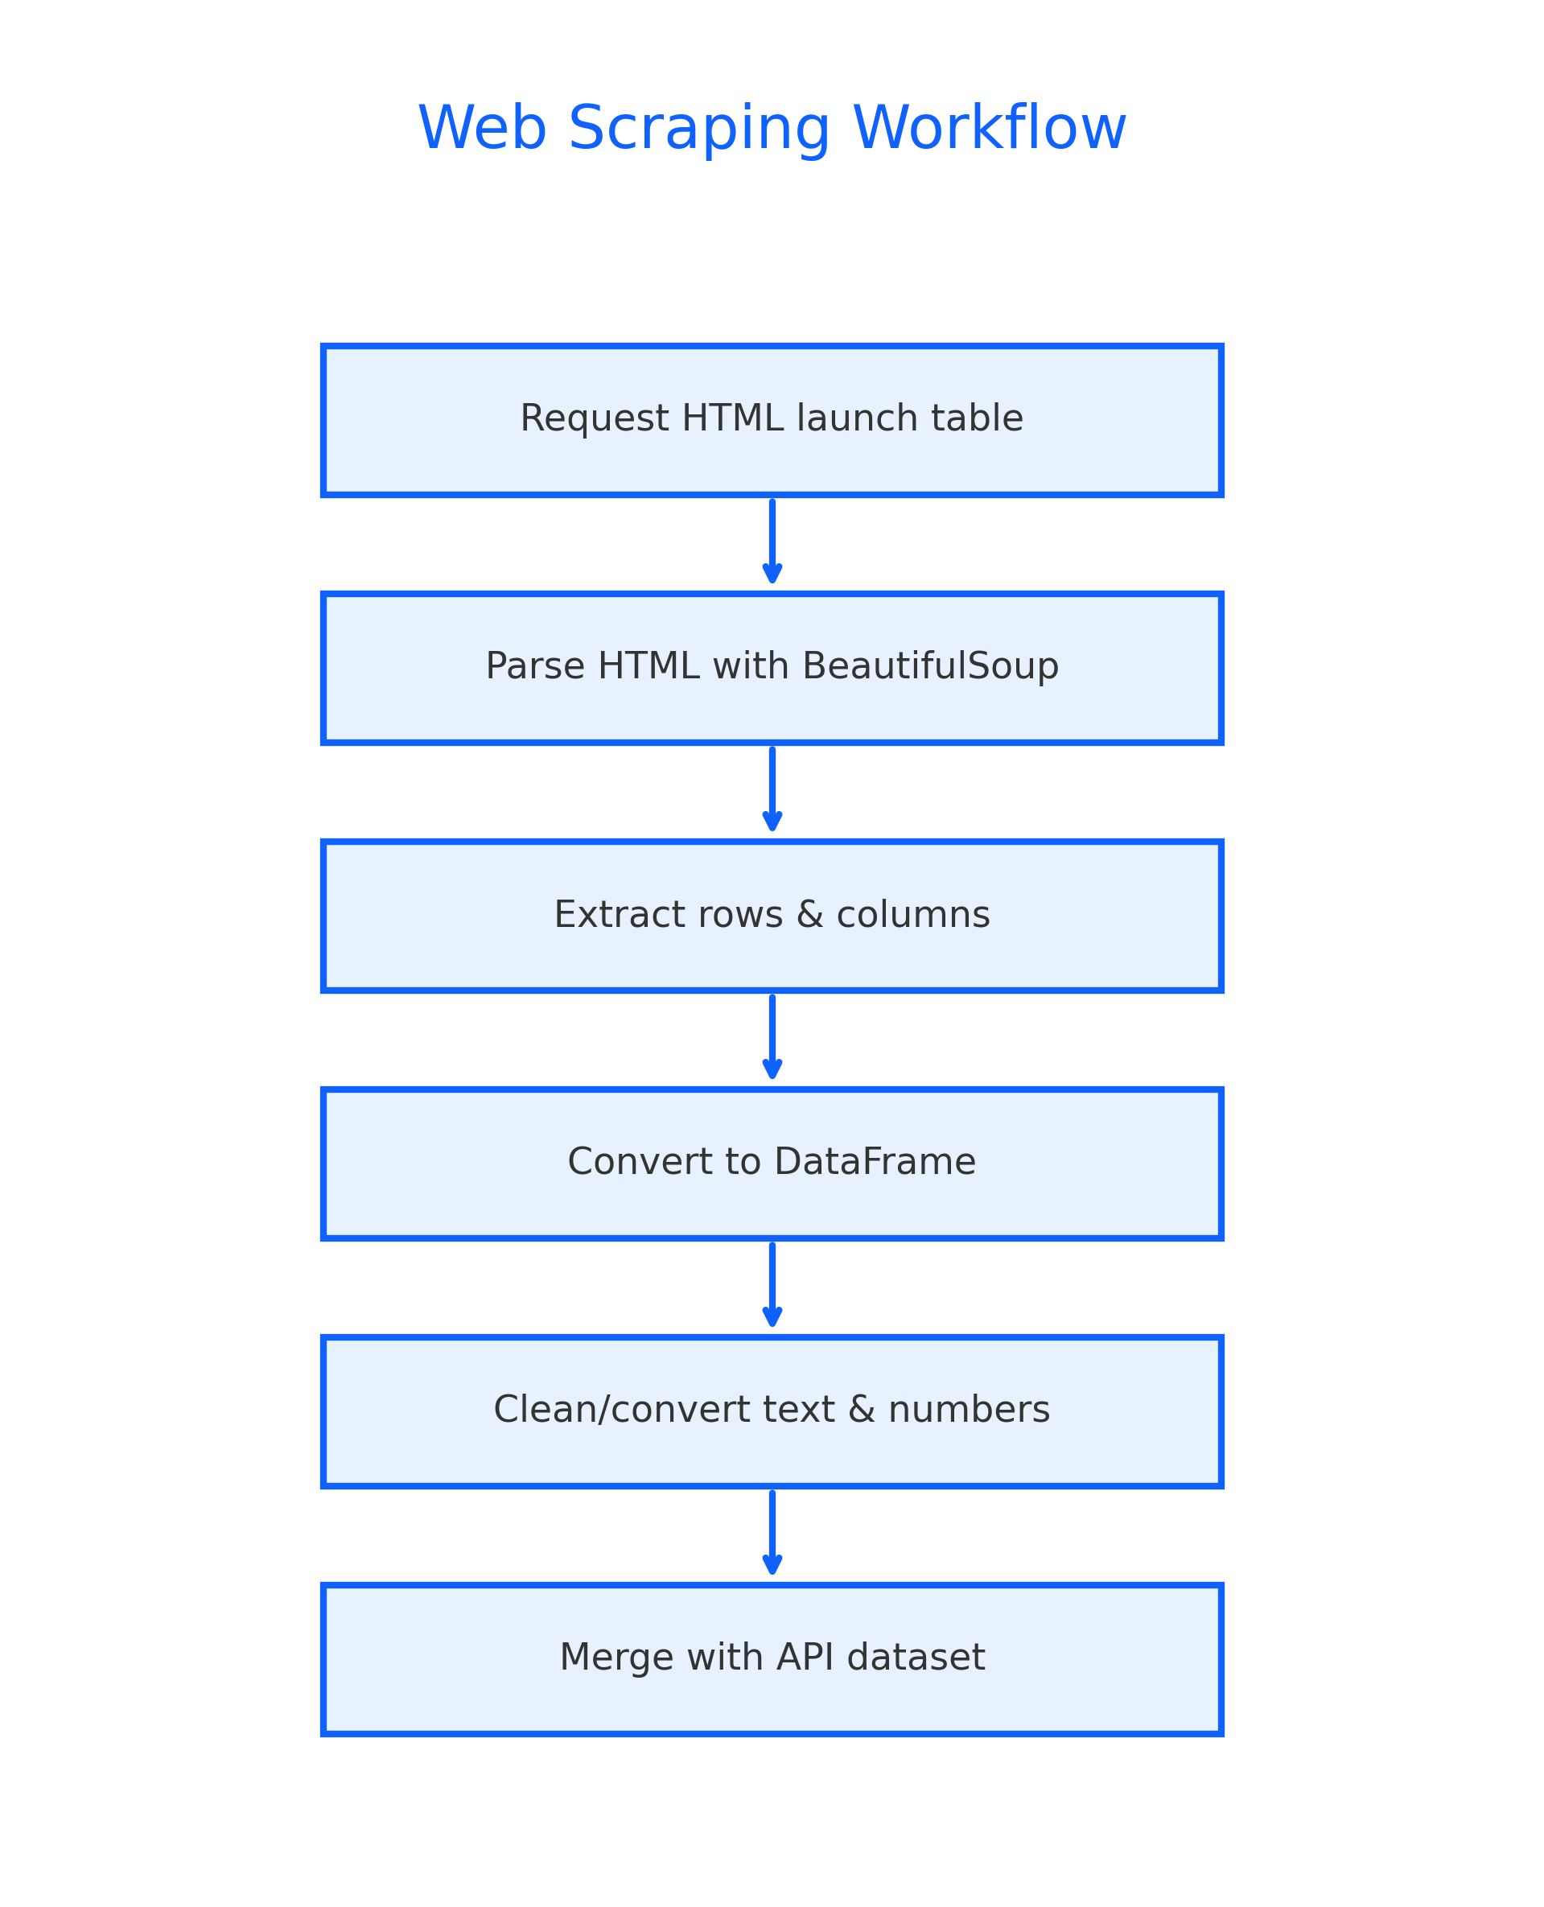
Data Collection - Scraping
Data Collection – Scraping
Scraped launch information from a public SpaceX launch table using requests + BeautifulSoup.
Extracted complementary attributes not available in the API, such as detailed payload information and mission identifiers.
Merged scraped results with API dataset to resolve missing values and improve data completeness.
https://github.com/GyorfiCsaba/AppliedDataScienceCapstone

Slide 10
Data Wrangling
Data Wrangling
Cleaned and standardized raw SpaceX launch data.
Converted date formats, corrected inconsistent text fields, and handled missing payload values.
Constructed the target variable (class: 1 = success, 0 = failure).
Engineered additional features:
Booster Version Category
Simplified Orbit Classification
One-hot encoded categorical variables.
Prepared the final dataset for EDA, dashboarding, and machine learning.
GitHub URL: https://github.com/GyorfiCsaba/AppliedDataScienceCapstone

Slide 11
EDA with Data Visualization
EDA with Data Visualization
Several exploratory charts were created to understand relationships between launch features and landing outcomes.
Scatter plots were used to compare Flight Number, Payload Mass, and Orbit Type against Launch Site, revealing patterns in success rates.
Bar charts highlighted the success rate distribution across different orbit types.
Line charts showed trends in landing success rates across years.
Correlation heatmaps helped identify the most influential variables for predicting landing success.
GitHub URL: https://github.com/GyorfiCsaba/AppliedDataScienceCapstone

Slide 12
EDA with SQL
EDA with SQL
SQL queries were used to validate trends observed in the Python visual analysis:
Retrieved unique launch sites.
Filtered records using pattern matching (e.g., sites starting with CCA).
Computed total payload mass for specific customers (e.g., NASA).
Calculated average payload mass for selected booster versions.
Identified the first successful ground landing date.
Queried success vs failure counts across all missions.
Found boosters carrying the maximum payload.
Ranked landing outcomes across a defined date range (2010–2017). https://github.com/GyorfiCsaba/AppliedDataScienceCapstone

Slide 13
Build an Interactive Map with Folium
Build an Interactive Map with Folium
Created an interactive Folium map to visualize:
Launch site locations using markers.
Launch outcomes using color-coded icons (green = success, red = failure).
Distance calculations from each launch site to nearby features such as coastline, roads, and railways.
These map objects help visually analyze geographical influence on landing outcomes.
Folium notebook: https://github.com/GyorfiCsaba/AppliedDataScienceCapstone

Slide 14
Build a Dashboard with Plotly Dash
Build a Dashboard with Plotly Dash
Added interactive components:
Launch Site Dropdown to filter results by site or view all sites.
Payload Range Slider to dynamically update mission results by selected payload interval.
Plots included in the dashboard:
Pie chart showing success counts (overall or per site).
Scatter plot comparing Payload vs. Landing Outcome with Booster Version color coding.
These interactions let users explore patterns and derive insights from mission data.
Dash notebook: https://github.com/GyorfiCsaba/AppliedDataScienceCapstone

Slide 15
Predictive Analysis (Classification)
Predictive Analysis (Classification)
Built several machine learning classification models to predict first-stage landing success.
Steps performed:
Preprocessed dataset (scaling, encoding).
Split data into training and test sets.
Trained Logistic Regression, SVM, KNN, and Decision Tree models.
Tuned hyperparameters using GridSearchCV.
Selected best-performing model based on cross-validation accuracy.
Best model: Decision Tree
Cross-validation accuracy ≈ 0.88
Test set accuracy ≈ 0.72
ML notebook: https://github.com/GyorfiCsaba/AppliedDataScienceCapstone

Slide 16
Results
Exploratory Data Analysis:
Identified relationships between payload, orbit type, booster category, and landing outcomes.
Interactive analytics (screenshots to be added):
Folium map results (launch site geography).
Dash dashboard output (success distribution, payload patterns).
Predictive Analysis:
Evaluated multiple ML models.
Selected Decision Tree as the most accurate and interpretable classifier.

Slide 17

Section 2

Slide 18
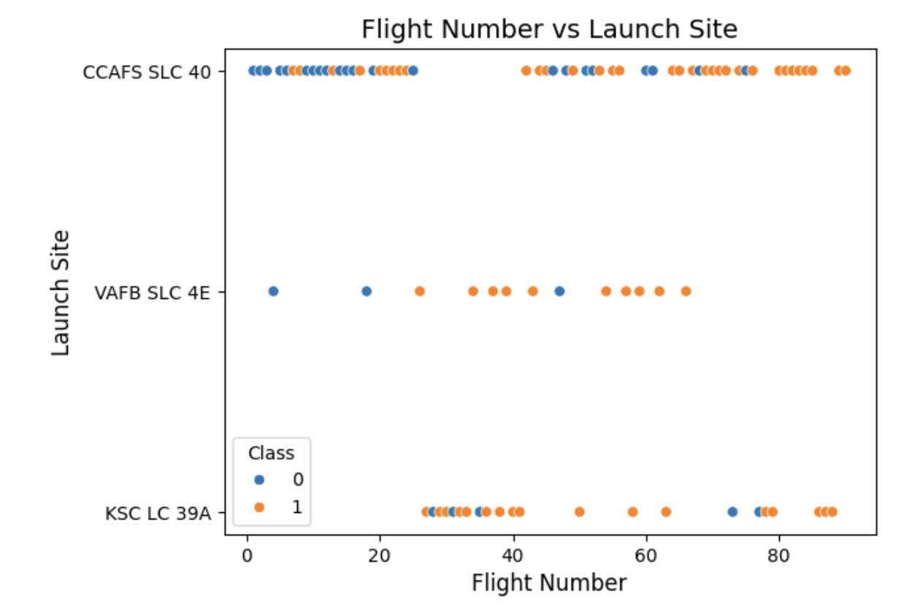
Flight Number vs. Launch Site
Flight Number vs. Launch Site
This scatter plot visualizes how launch experience (Flight Number) varies across SpaceX launch sites.
Higher flight numbers generally correspond to later missions, which tend to show improved landing success due to engineering advancements.
Differences across sites reflect how frequently each site is used and how mission types vary.

Slide 19
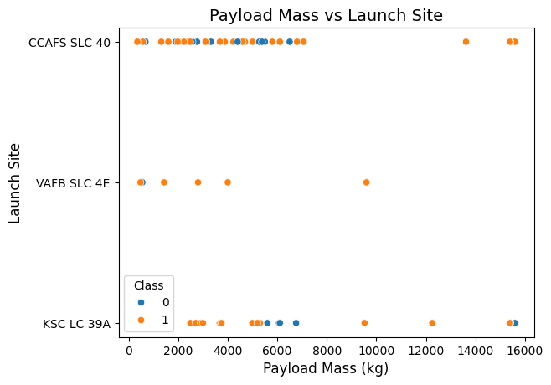
Payload vs. Launch Site
This plot compares Payload Mass (kg) across launch sites.
Some sites handle significantly heavier payloads, which impacts mission complexity and landing outcomes.
Notable clusters indicate preferred launch sites for different payload categorie

Slide 20
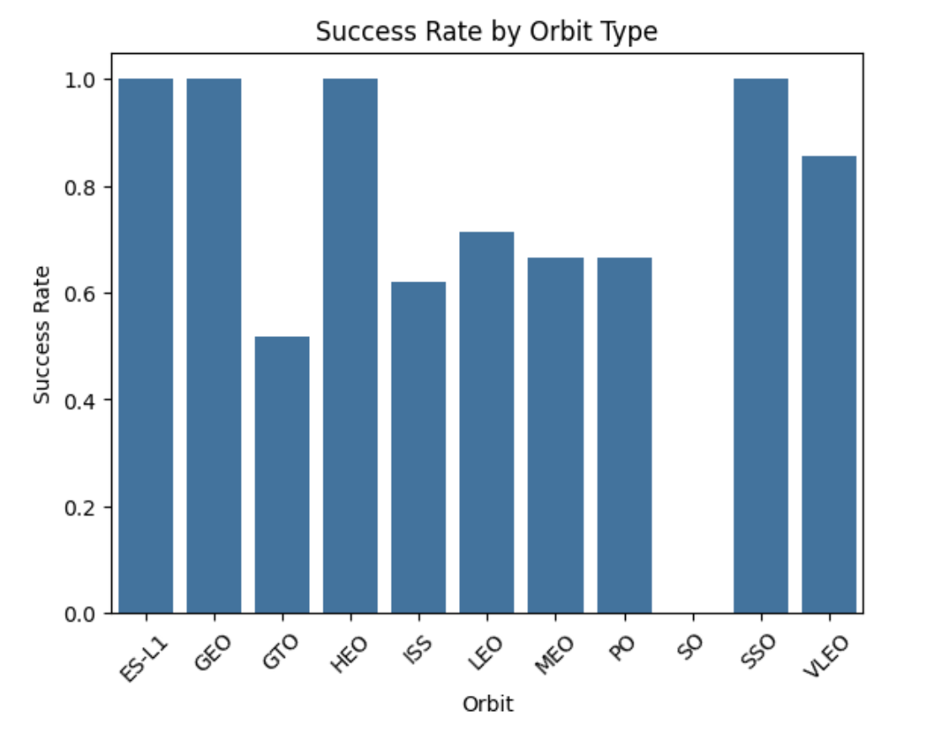
Success Rate vs. Orbit Type
A bar chart shows how landing success probability varies by orbit type.
Lower-energy orbits (LEO) typically have higher success rates, while high-energy orbits like GTO show lower success.
Understanding orbit-related performance helps refine mission risk assessments.

Slide 21
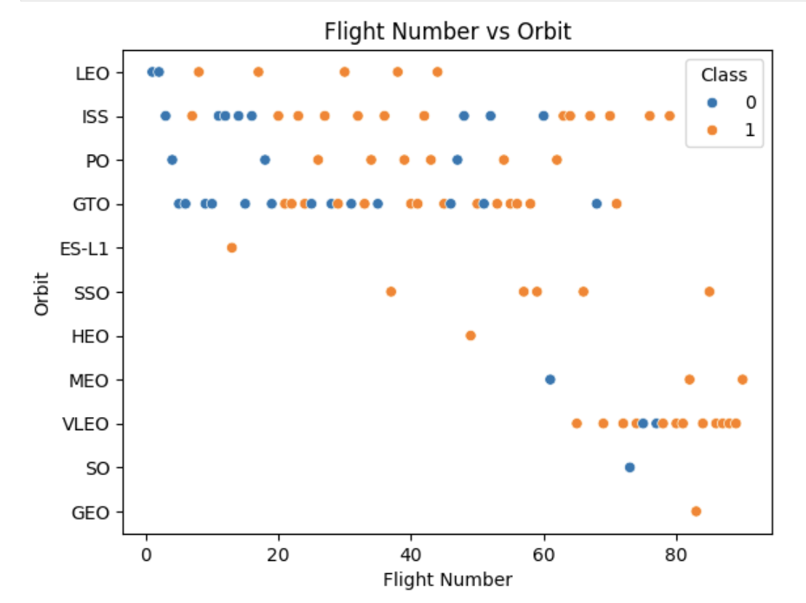
Flight Number vs. Orbit Type
This scatter plot compares Flight Number with Orbit Type, helping to identify how mission profiles evolved over time.
Higher flight numbers represent more recent missions, where improvements in booster design and operations are reflected in better landing outcomes.
The distribution across orbit types shows which orbits became more common as SpaceX expanded its launch capabilities.

Slide 22
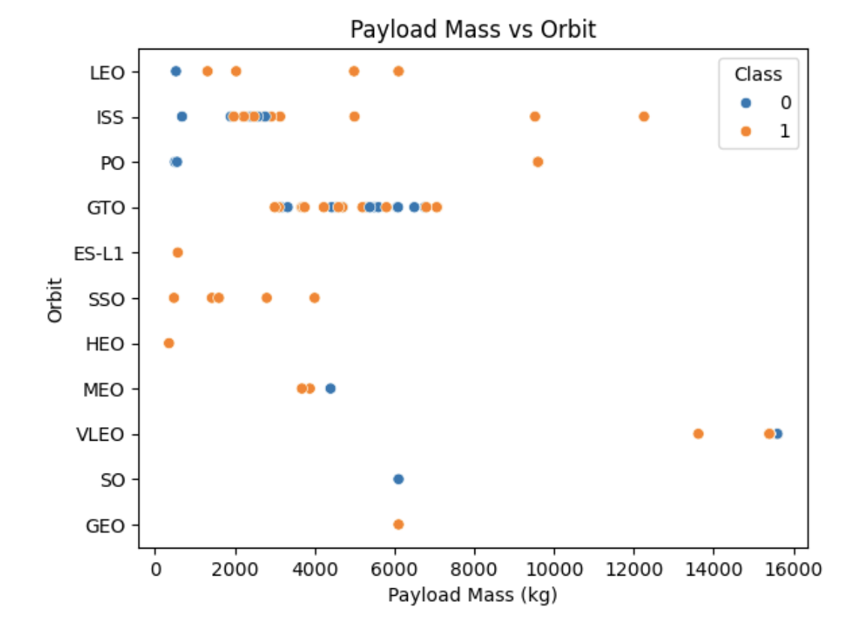
Payload vs. Orbit Type
This plot illustrates how payload mass (kg) varies across orbits such as LEO, MEO, GEO, GTO, and SSO.
Heavier payloads tend to be associated with more energy-intensive orbits, influencing mission difficulty and landing success.
Visual clustering helps identify which orbits typically carry higher or lower payload categories.

Slide 23
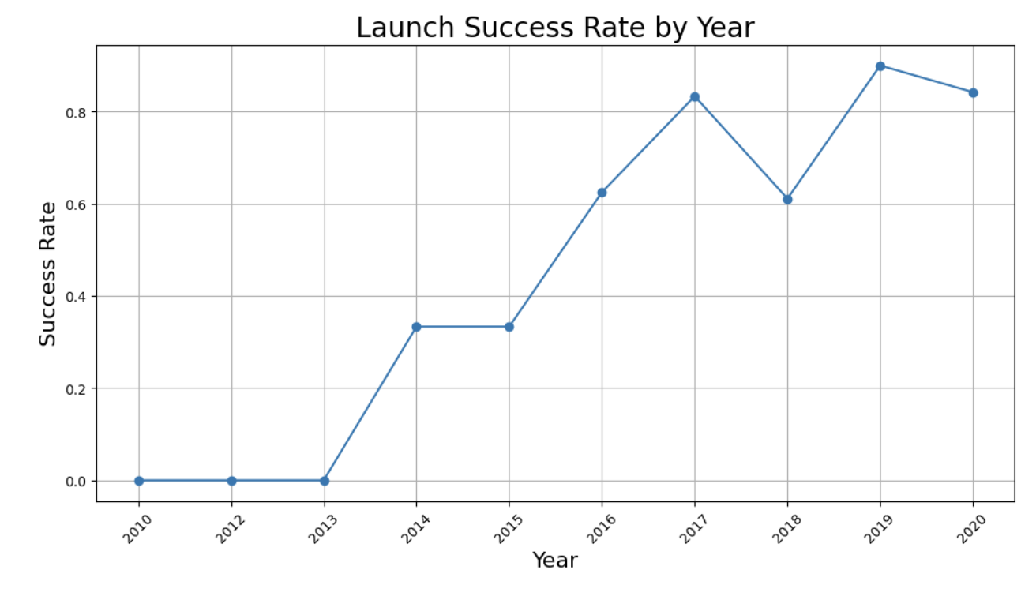
Launch Success Yearly Trend
A line chart was created to show the average landing success rate per year.
The upward trend reflects SpaceX’s rapid technological improvements in booster reusability.
Early years show inconsistent outcomes; later years exhibit strong, stable success rates, aligning with the introduction of improved booster versions like F9 FT and Block 5.

Slide 24
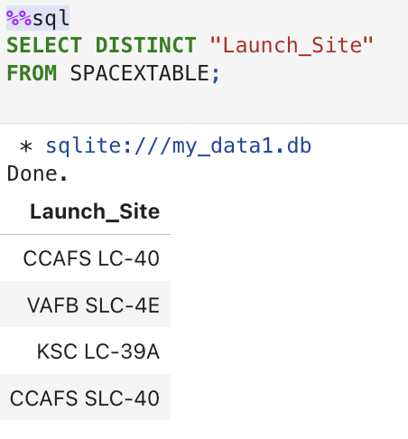
All Launch Site Names
SQL query retrieved all unique launch site names from the dataset.
This confirms the presence of the four official SpaceX sites used during the analyzed timeframe:
KSC LC-39A
CCAFS LC-40
VAFB SLC-4E
CCAFS SLC-41 (depending on dataset version)
These names form the basis for site-level analysis in later slides.

Slide 25
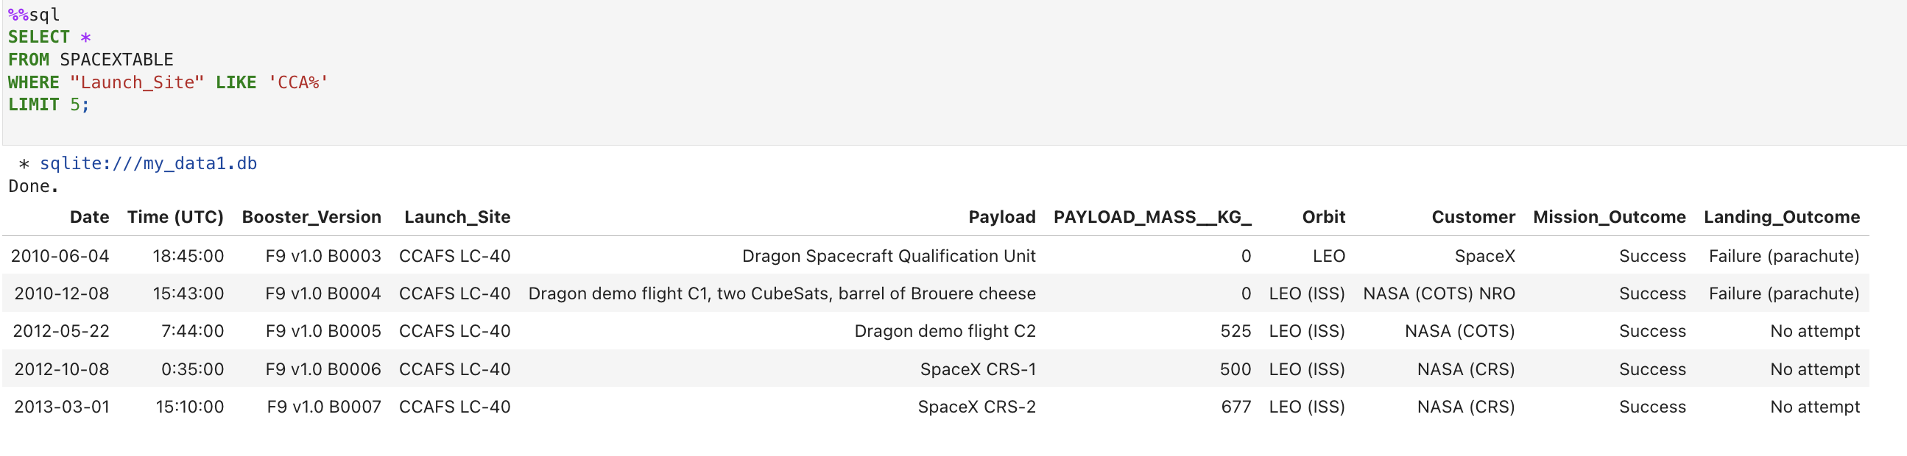
Launch Site Names Begin with 'CCA'
SQL query used pattern matching (LIKE 'CCA%') to filter launch sites whose names begin with "CCA".
This returns Cape Canaveral–related pads, e.g.:
CCAFS LC-40
CCAFS SLC-41
This demonstrates use of SQL string filtering in exploratory analysis.

Slide 26
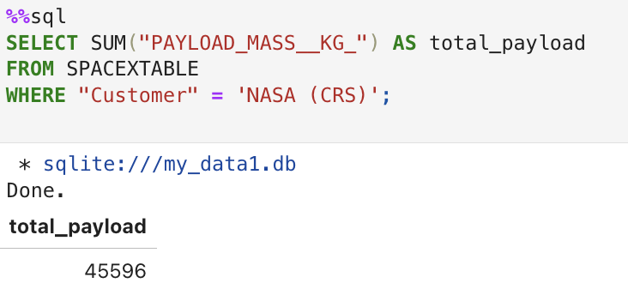
Total Payload Mass
omputed the total payload mass carried by boosters for NASA missions.
This helps quantify NASA’s utilization of Falcon 9 platform and total delivered mass to orbit.
The result represents cumulative payload over all NASA-related launches in the dataset.

Slide 27
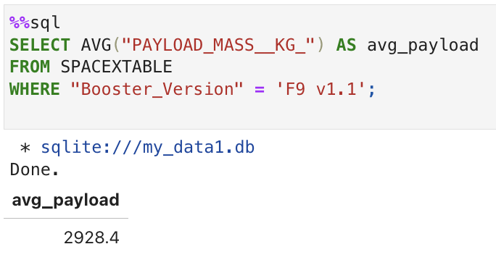
Average Payload Mass by F9 v1.1
SQL query calculated the average payload mass carried by booster version Falcon 9 v1.1.
This provides insight into the performance envelope of earlier Falcon 9 versions.
Comparing averages across booster types helps understand engineering improvements over time.

Slide 28
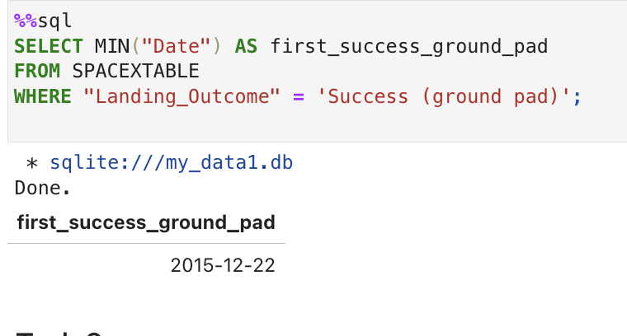
First Successful Ground Landing Date
Retrieved the earliest date where the landing outcome was Success (ground pad).
This marks a historical milestone for SpaceX, as successful ground landings enabled rapid refurbishment and reuse.
The date confirms when reusability first became operationally reliable.

Slide 29
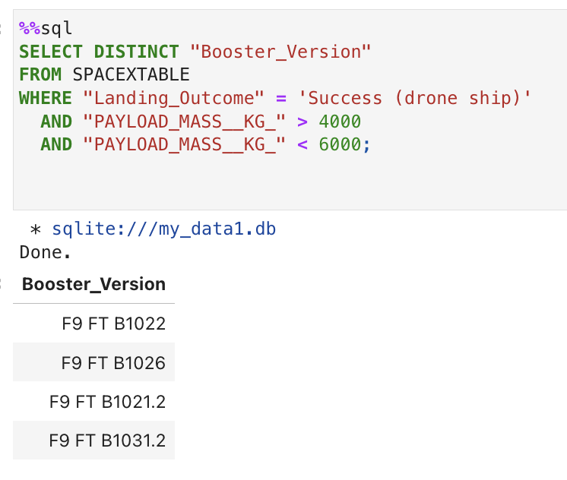
Successful Drone Ship Landing with Payload between 4000 and 6000
QL query filtered missions that:
Landed successfully on a drone ship, and
Carried payload mass between 4000 and 6000 kg.
These missions demonstrate booster performance under high-payload, offshore recovery profiles.
Result includes the booster IDs that met these criteria.

Slide 30
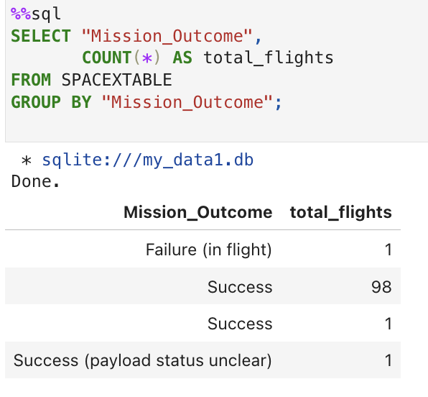
Total Number of Successful and Failure Mission Outcomes
SQL aggregation counted total successful vs failed landing outcomes across all missions.
Provides a clear summary of Falcon 9 landing reliability.
The ratio between successes and failures shows substantial improvement over the years.

Slide 31
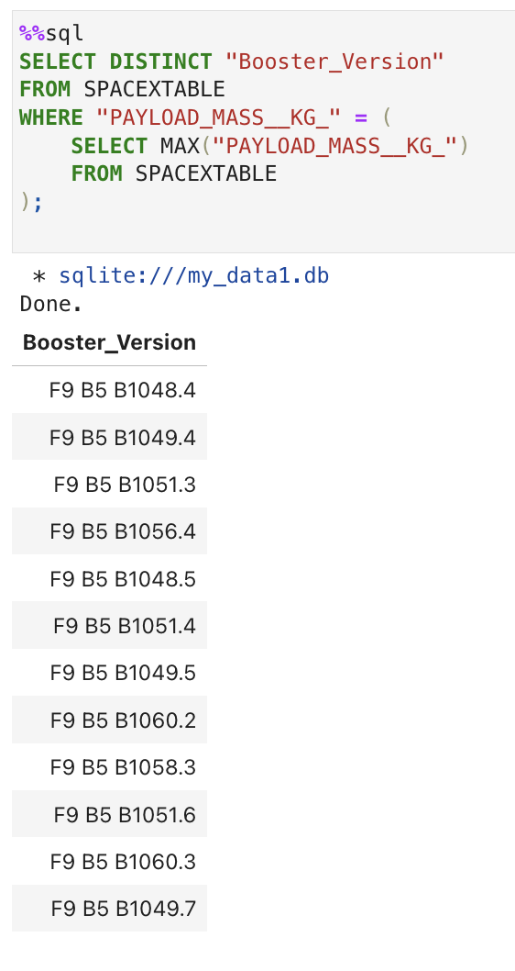
Boosters Carried Maximum Payload
SQL query was used to identify the booster(s) associated with the highest payload mass.
This result highlights the missions that pushed Falcon 9’s lift capacity to its limits.
Knowing which boosters handled the maximum payload helps understand performance differences between older and newer booster versions.

Slide 32
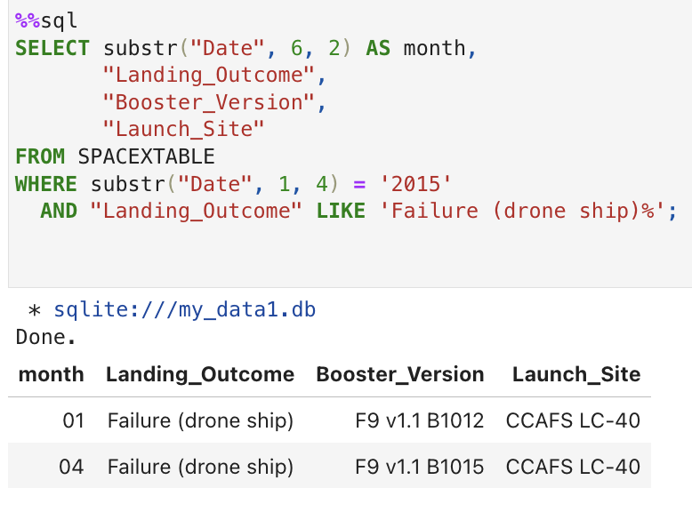
2015 Launch Records
Retrieved launch records from year 2015 where the landing outcome was a failure on drone ship.
Query outputs include:
Booster version
Launch site
Landing outcome
These failures represent the early phase of SpaceX’s ocean-based recovery attempts, before the technique became more reliable.
here

Slide 33
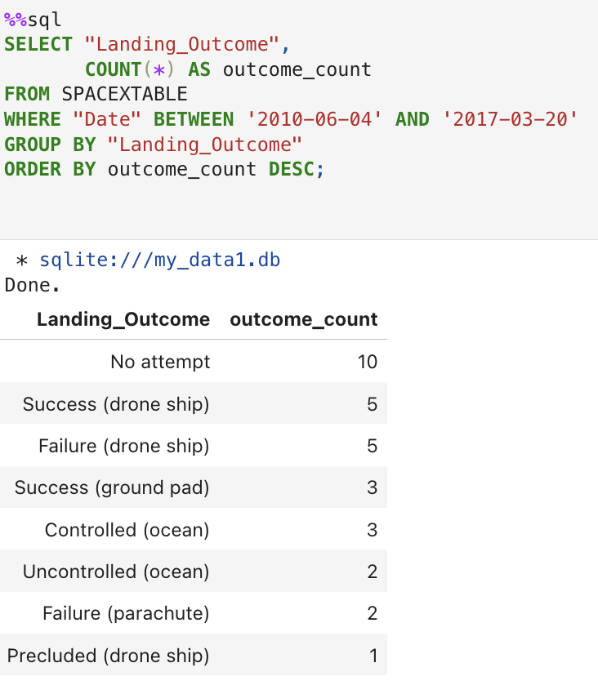
Rank Landing Outcomes Between 2010-06-04 and 2017-03-20
SQL query ranked landing outcomes in descending order based on frequency within the selected date range.
Shows how often each outcome occurred, such as:
Success (ground pad)
Success (drone ship)
Failure (drone ship)
Failure (ground pad)
This ranking helps visualize SpaceX’s rapid improvements in booster recovery during this period.

Slide 34

Section 3

Slide 35
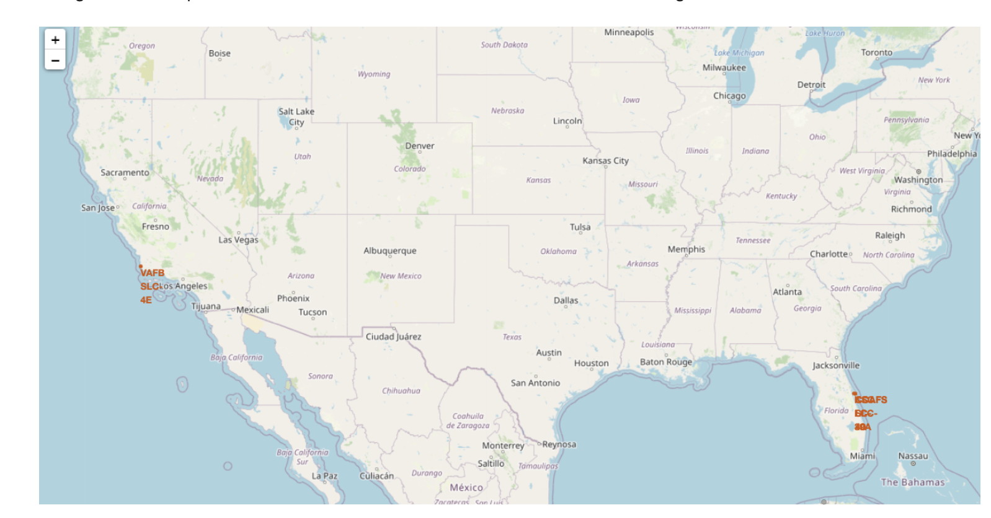
Global Launch Site Map
This Folium map displays all SpaceX launch sites worldwide, marked with interactive location pins.
It provides a geographical overview of where Falcon 9 missions originate.
Marker tooltips include the site name and coordinates, allowing users to explore spatial context easily.

Slide 36
Launch Outcomes by Site (Color-Coded Markers)
This Folium map visualizes landing outcomes using distinct colors:
Green markers → Successful landings
Red markers → Failed landings
The spatial pattern reveals which launch sites have the highest success density.
This helps identify operational differences across locations.
Explain the important elements and findings on the screenshot

Slide 37
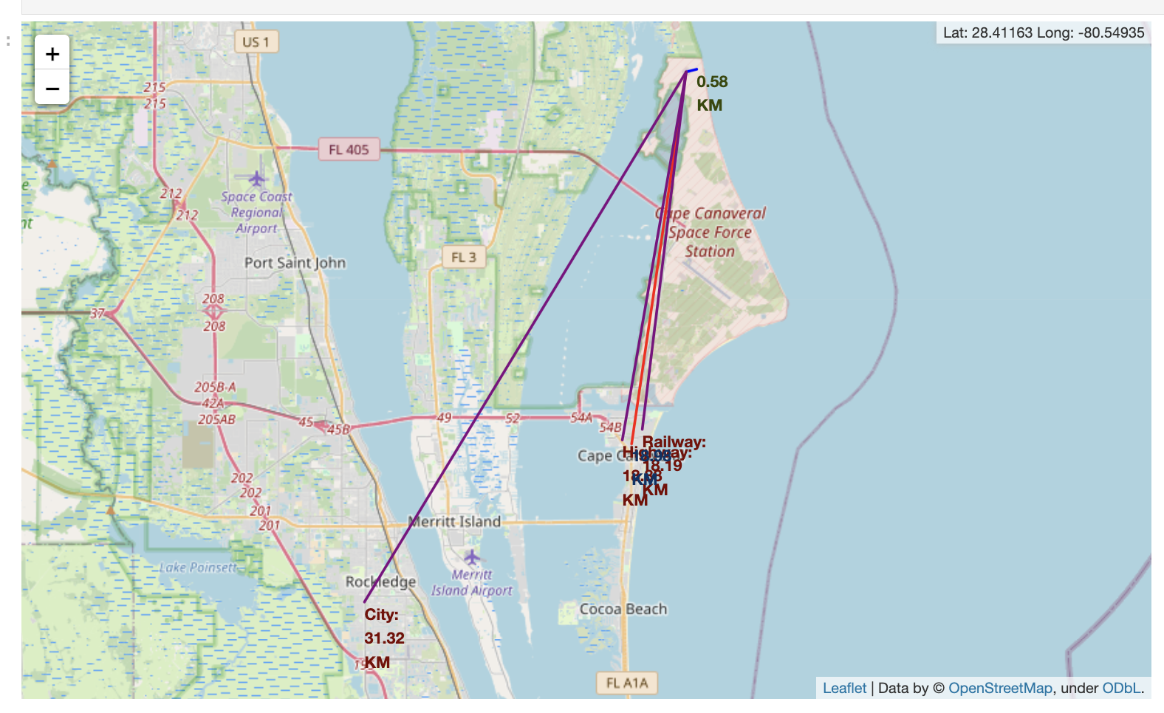
Proximity Analysis of Launch Site Infrastructure
This screenshot focuses on a selected launch site and shows:
Nearby coastline
Highways, railroads, or logistic routes
Calculated distances from the site to the closest infrastructure
This analysis is useful to understand safety margins, logistics, and site selection rationale.

Slide 38

Section 4

Slide 39
Launch Success Counts Across All Sites
Pie chart shows the total number of successful launches for each launch site when “All Sites” is selected.
This gives an immediate understanding of which sites contribute most to overall mission success.
Differences in slice size reflect varying launch frequencies and performance history.

Slide 40
Success Ratio for Top-Performing Launch Site
When a specific launch site is selected in the dashboard, the pie chart updates to show its success vs failure ratio.
This view highlights which site has the highest success rate, typically KSC LC-39A for this dataset.
This breakdown helps compare operational reliability across sites.

Slide 41
Payload vs. Launch Outcome Scatter (All Sites)
This scatter plot visualizes Payload Mass (kg) versus Launch Outcome (class) for all launch sites.
The range slider allows selecting different payload intervals, revealing success patterns across payload categories.
Key insights from this chart typically show:
Mid-range payloads (≈2000–5000 kg) exhibit the highest success rates.
Extremely low or high payloads often correlate with more failures.
Booster version categories (colored groups) highlight which generations perform best.

Slide 42

Section 5

Slide 43
Classification Accuracy
A bar chart was generated to compare the accuracy of all trained classification models:
Logistic Regression
SVM
K-Nearest Neighbors
Decision Tree (best performer)
The Decision Tree achieved the highest cross-validation accuracy (~0.88).
On the test set, the Decision Tree model reached an accuracy of ~0.72, showing strong generalization for this dataset.
Find which model has the highest classification accuracy

Slide 44
Confusion Matrix
The confusion matrix of the Decision Tree model shows its performance on the test set:
True Positives (TP): Correctly predicted successful landings
True Negatives (TN): Correctly predicted failed landings
False Positives (FP): Predicted success where actual outcome was failure
False Negatives (FN): Predicted failure where actual outcome was success
Interpretation:
The model correctly identifies most successful landings.
Misclassifications occur mostly in borderline cases with unusual payloads or rare orbits.

Slide 45
Conclusions
Successfully built a complete end-to-end data science workflow using real SpaceX launch data.
EDA revealed key factors influencing landing success:
Launch site
Booster version category
Payload mass
Orbit type
Interactive analytics (Folium + Dash) provided deeper insights into spatial and operational patterns.
Machine learning models were developed and evaluated, with the Decision Tree emerging as the best performer.
Predictive modeling demonstrates how data-driven tools can support launch planning, cost estimation, and risk assessment.

Slide 46
Appendix
dditional resources and artifacts from this project may include:
Python code snippets
SQL queries used in EDA
DataFrames, tables, and extended outputs
Extra diagnostic plots
Notebook references and intermediate results
Full project repository:
https://github.com/GyorfiCsaba/AppliedDataScienceCapstonet

Slide 47


